Slide 1
Hot Soldering
Going with the flow

Slide 2
Learning Soldering Basics
Identify tools and components
Cover basic soldering techniques for through-hole and surface-mount
Share tips and tricks
Demo
Hands-on practice

Slide 3

Whoami
Katie Lunceford - @r0gu3bull3t
System Security & Network Security Engineer
Soldering for 16 years
Happily married, insta-mom of 3 awesome kids
We have 5 dogs and 1 cat

Slide 4
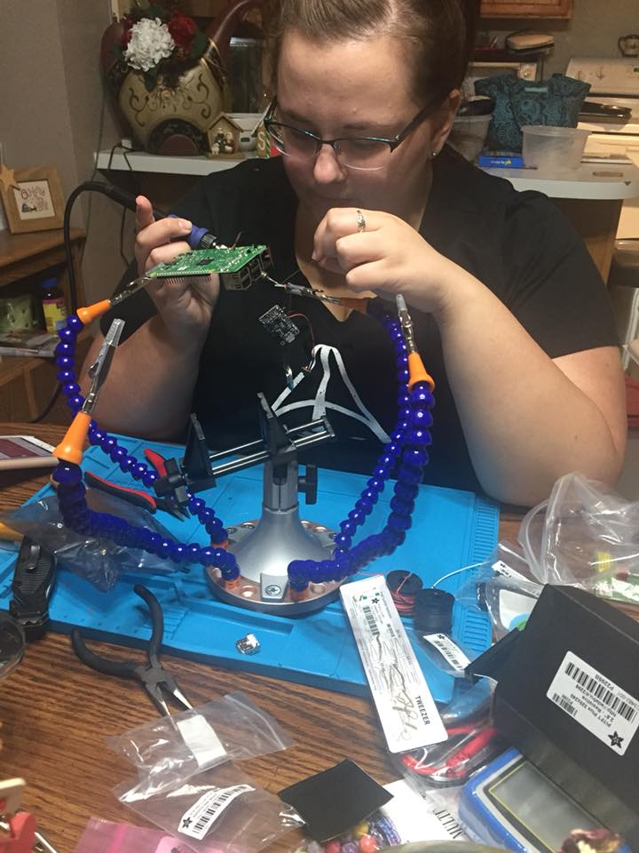
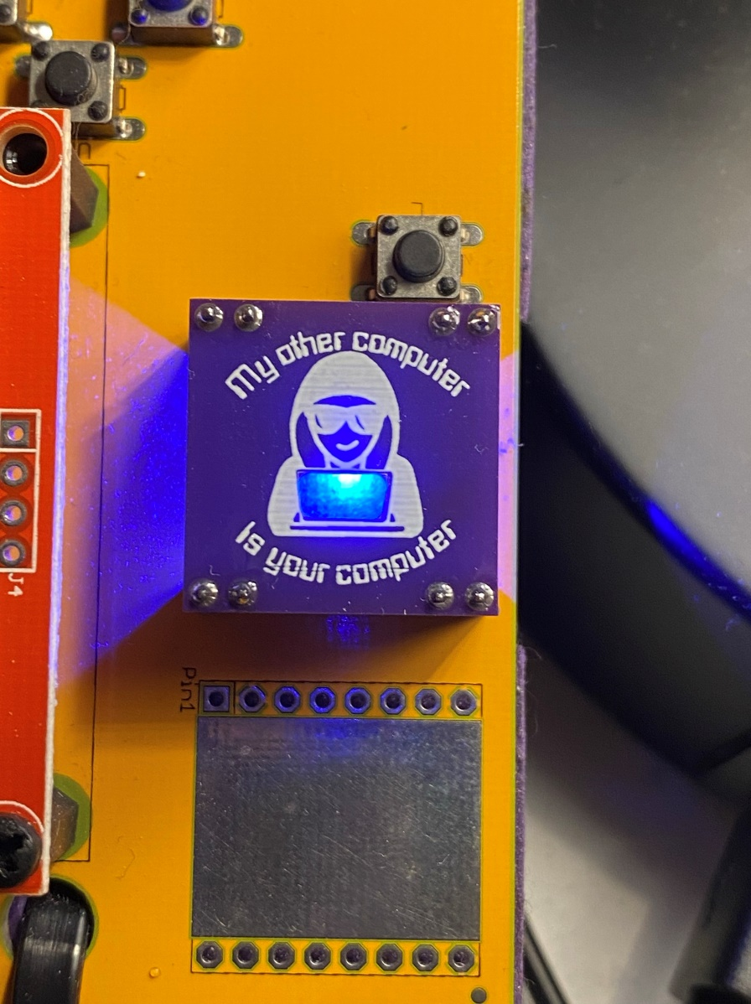
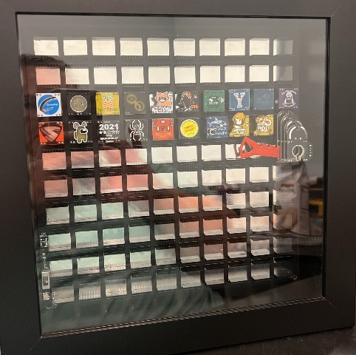
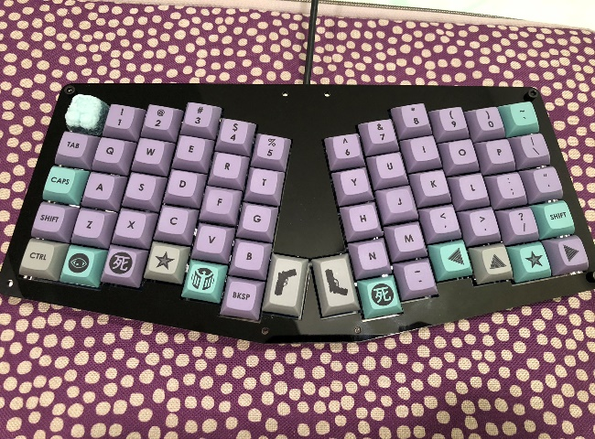
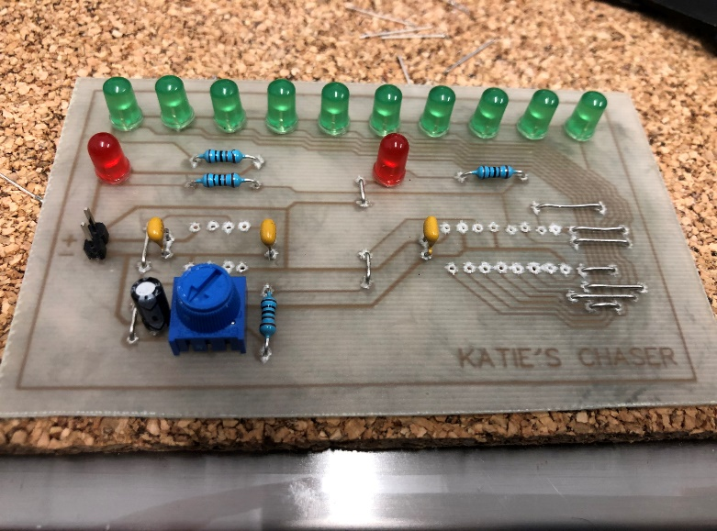
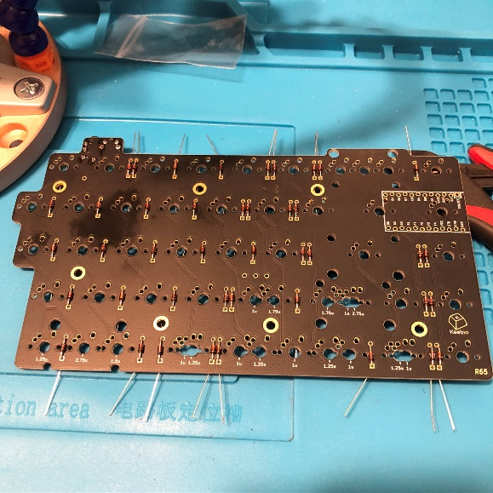
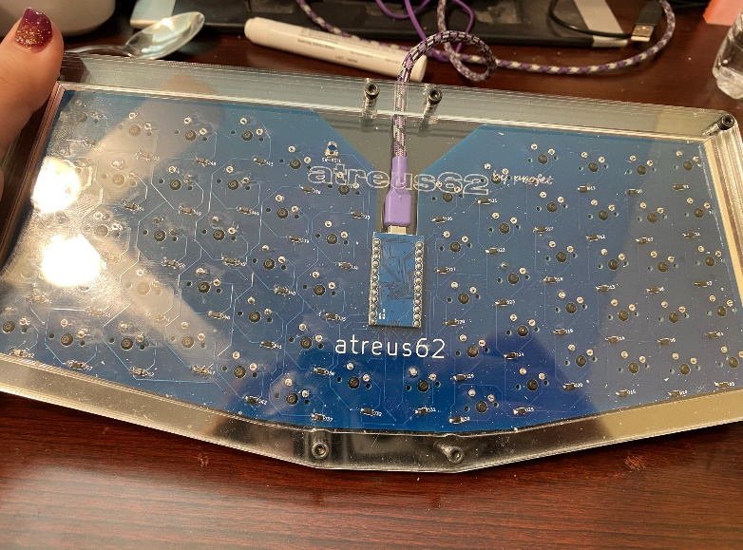
Some of my projects

Slide 5
Tools and supplies

Slide 6

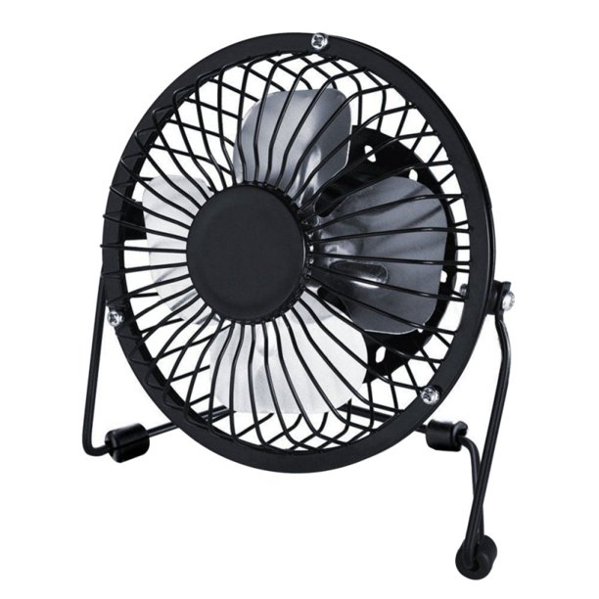
Tools
Good lighting
ventilation

Slide 7
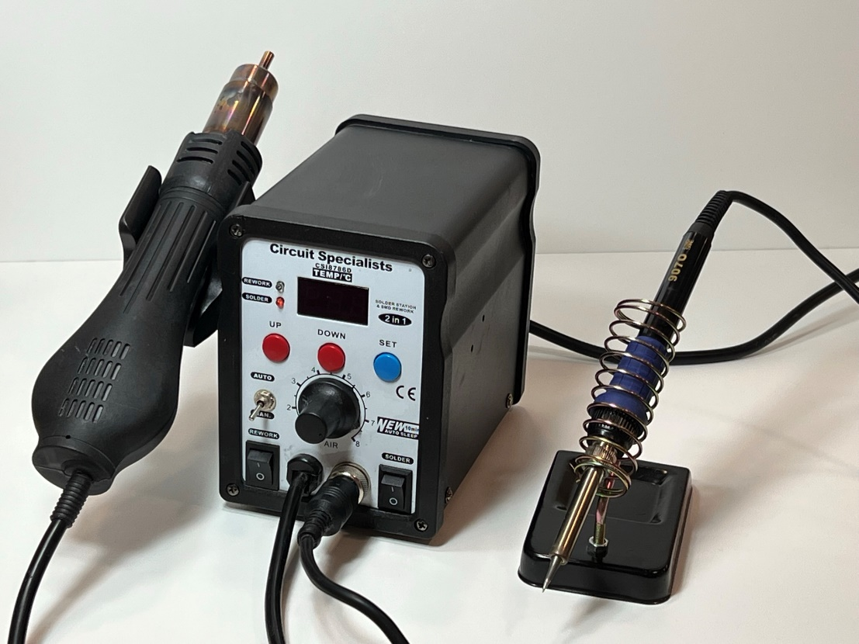
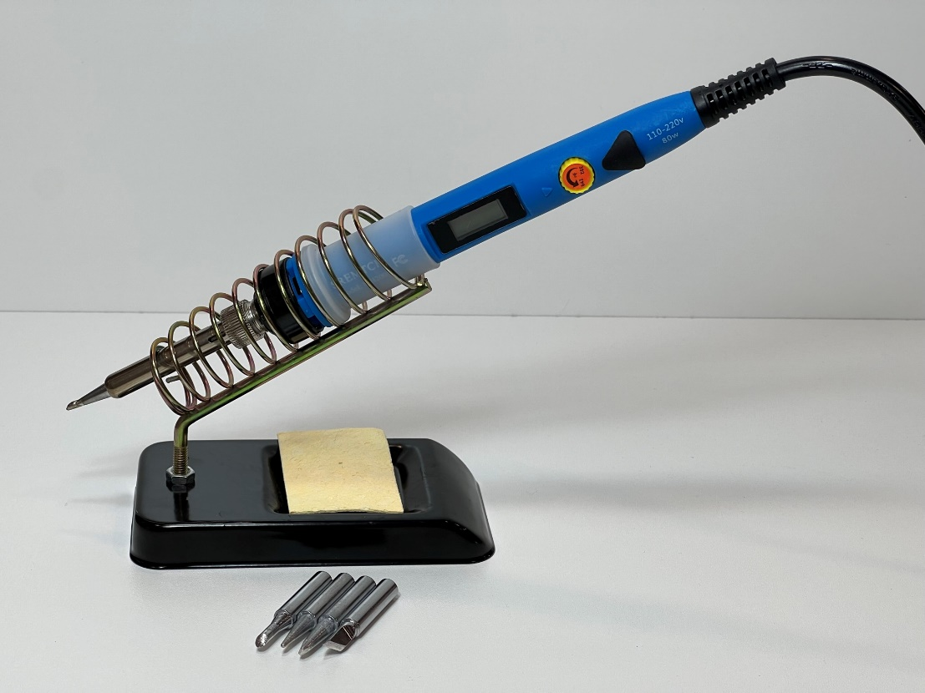
Solder station
Solder iron

Slide 8
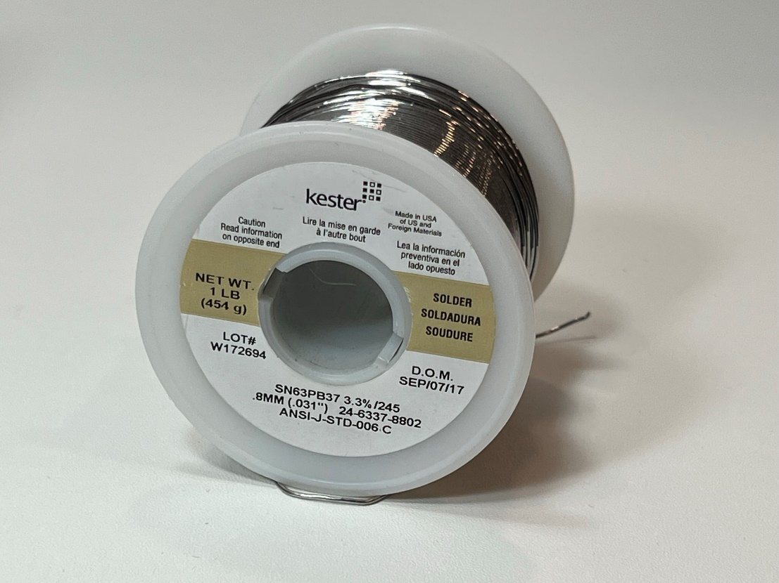
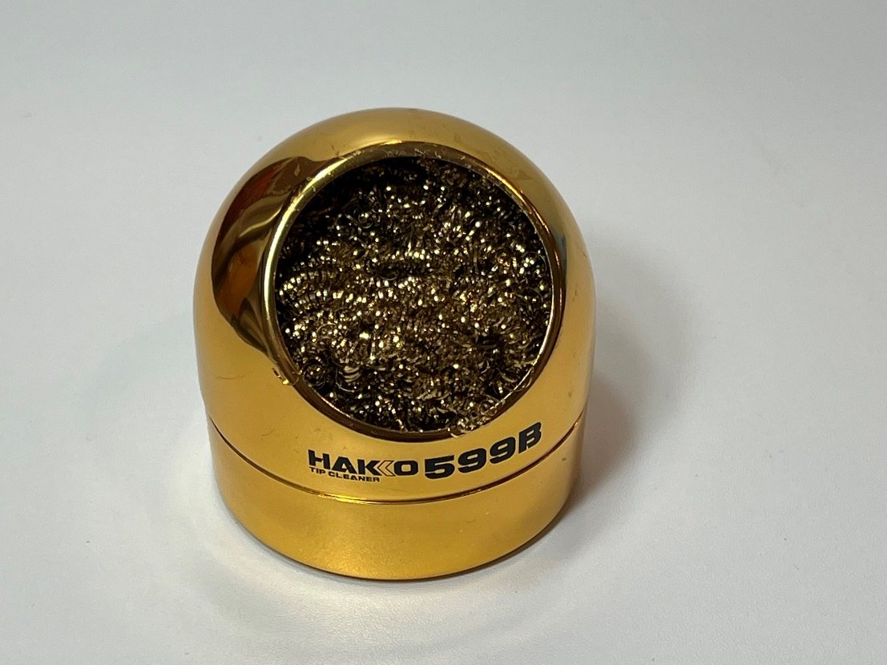
solder
Solder iron cleaner

Slide 9
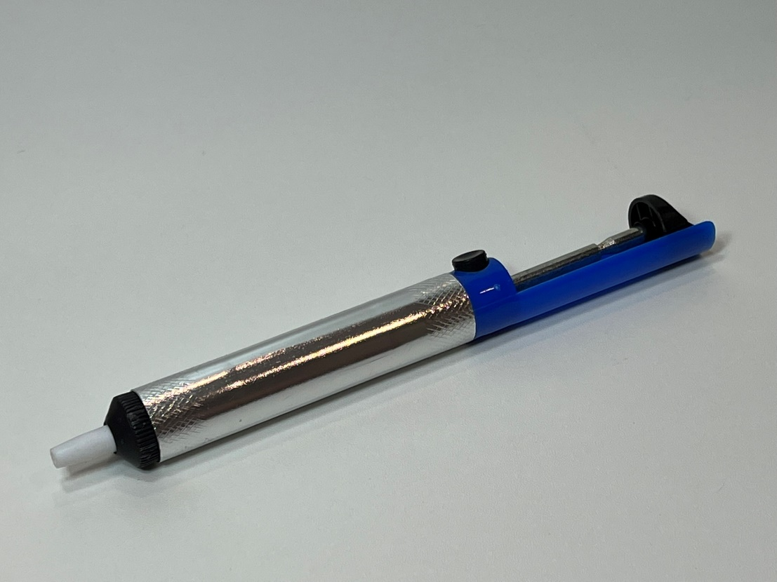
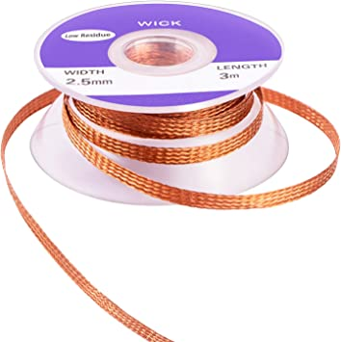
Solder sucker
Solder wick

Slide 10
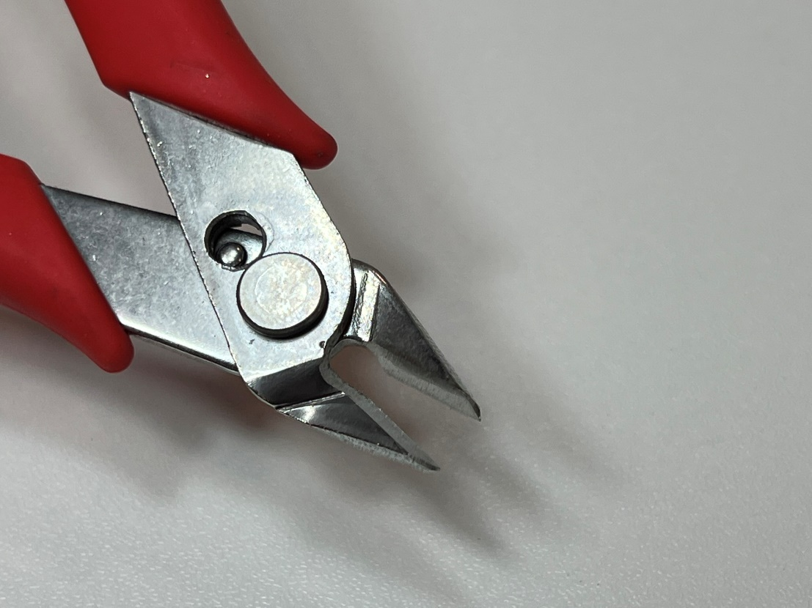
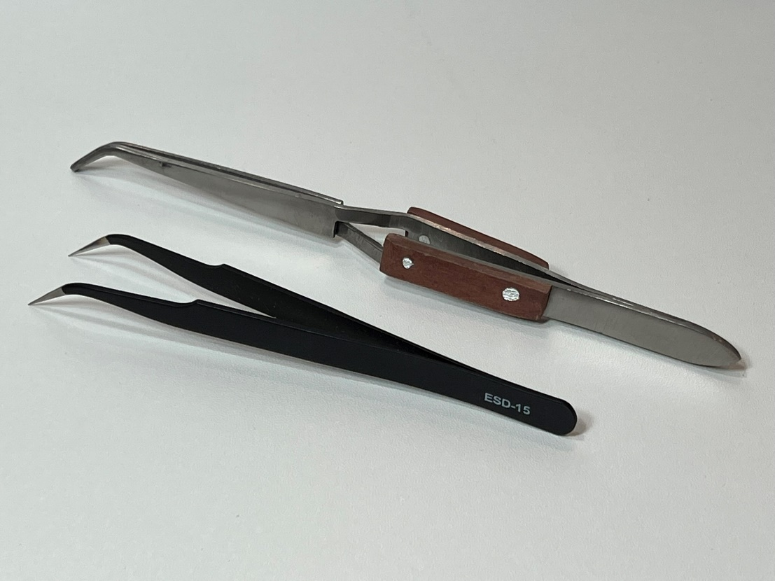
Angle flush cutters
tweezers

Slide 11
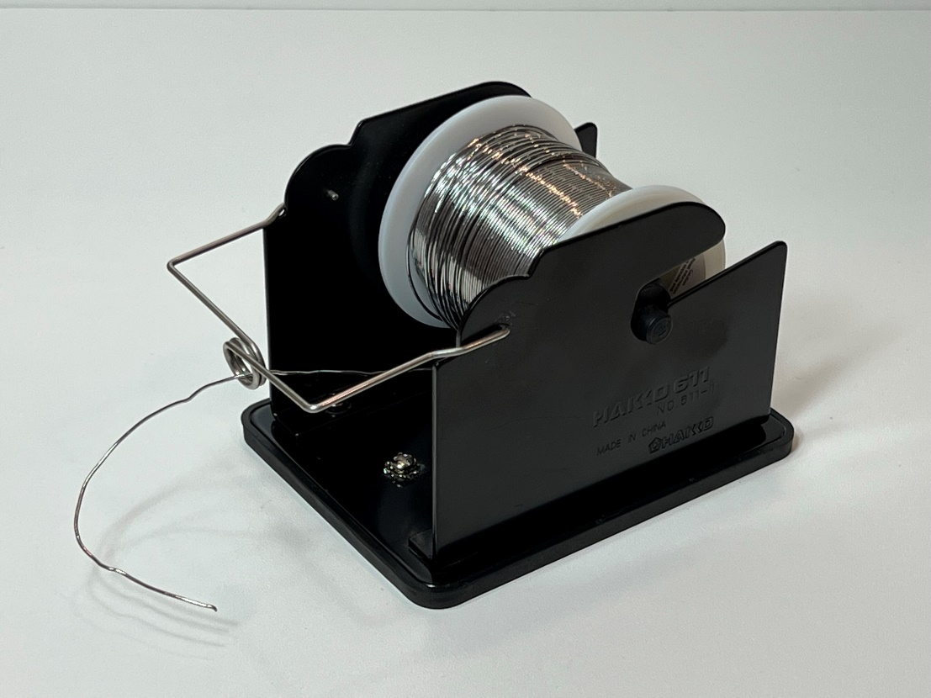
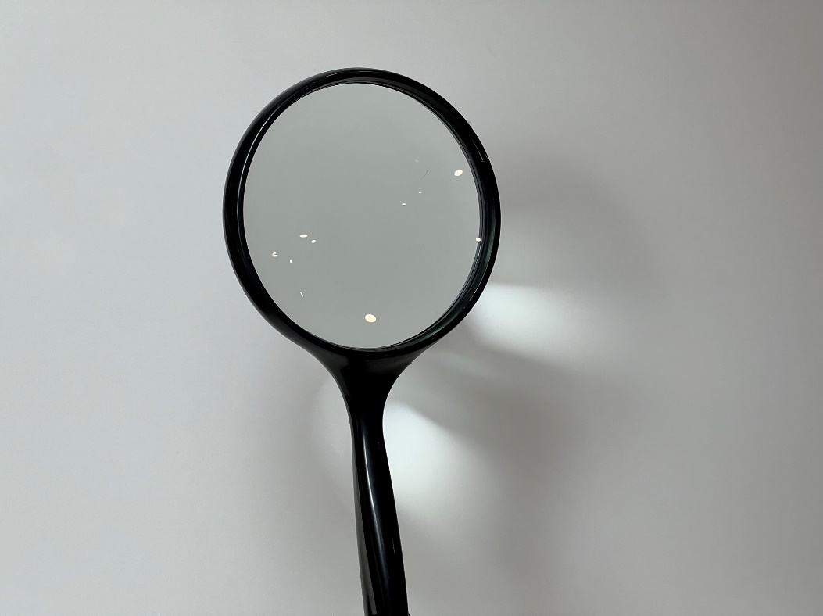
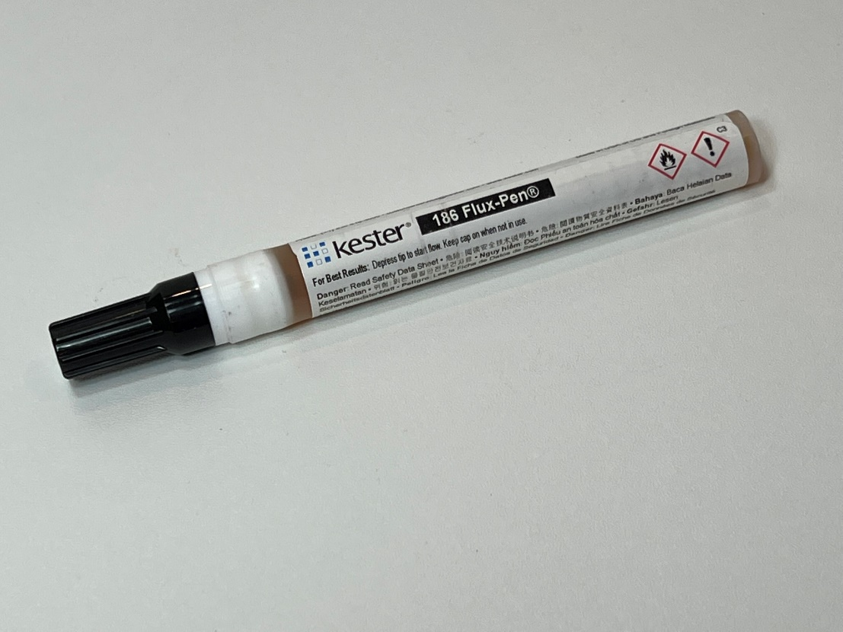
Solder holder
Magnifying
Glass Flux pen

Slide 12
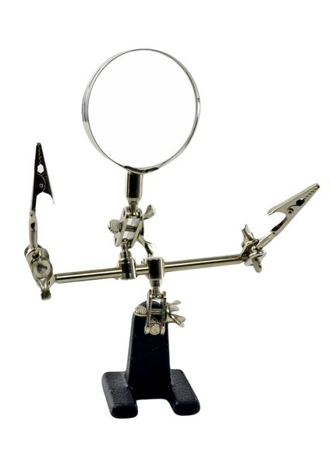
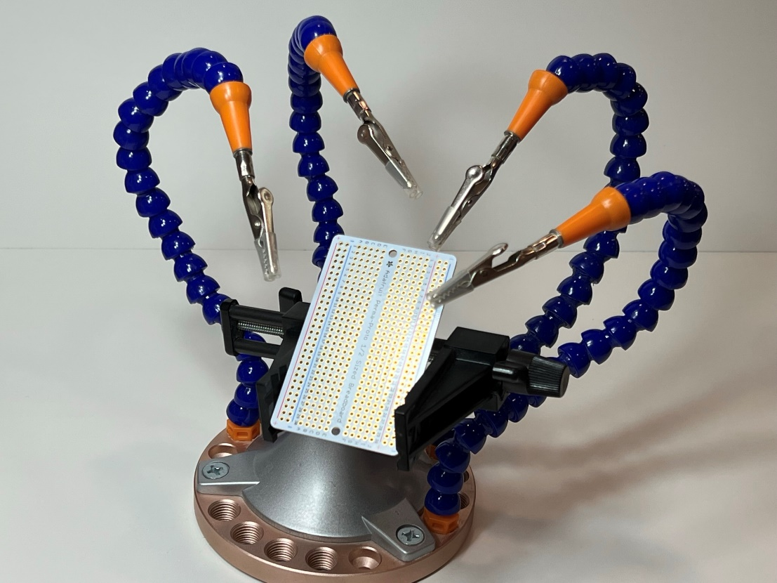
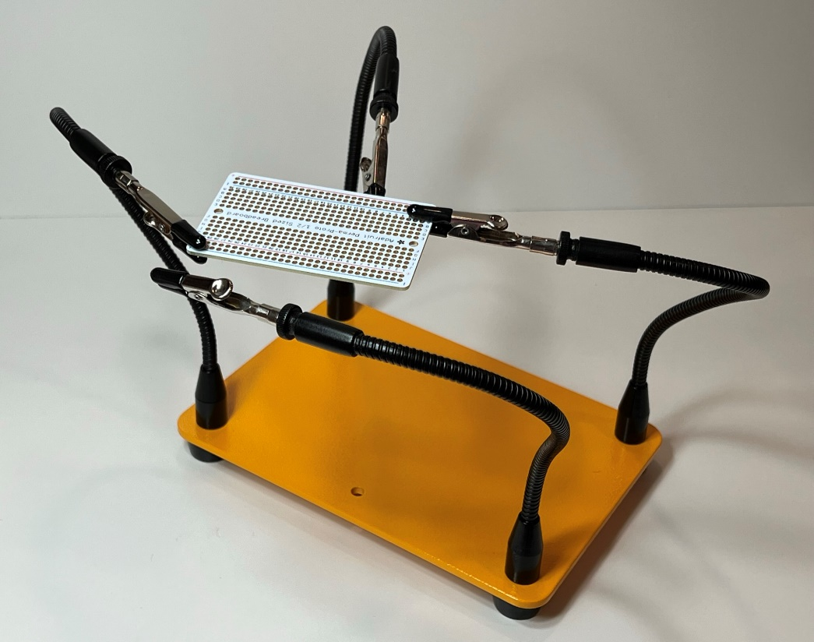
Helping hand
Panavise

Slide 13
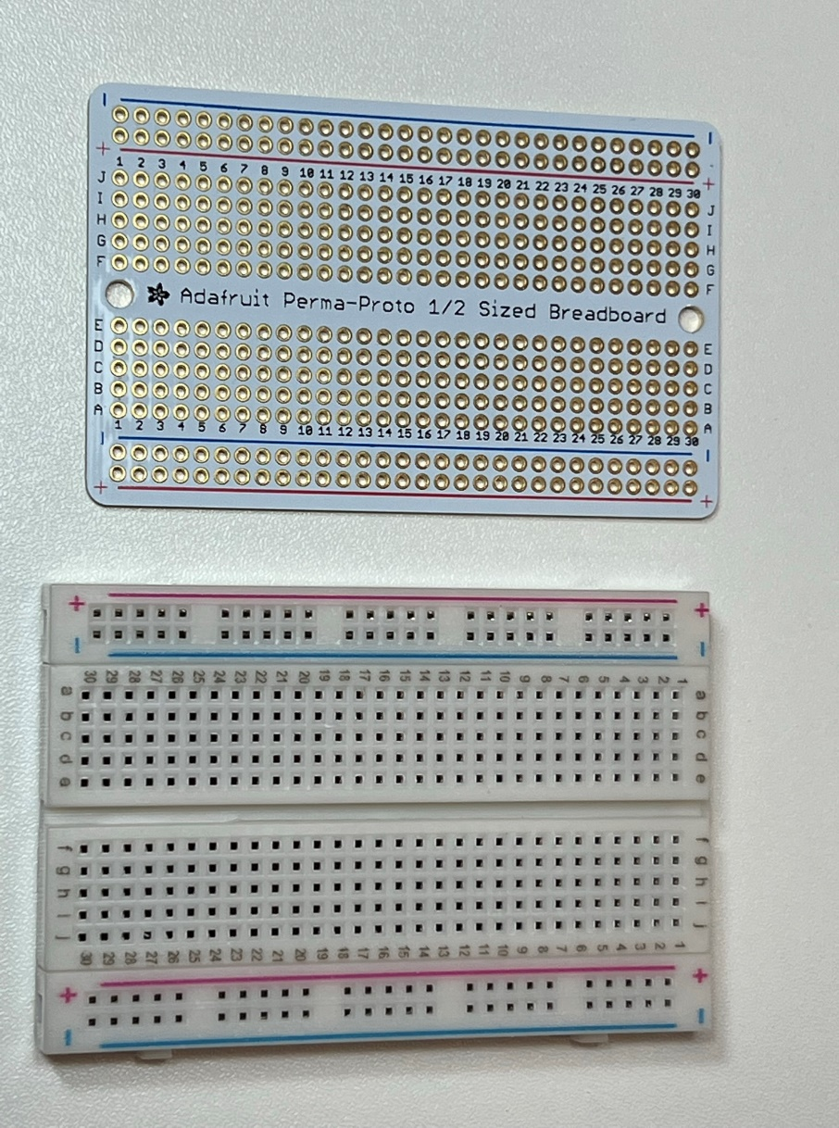
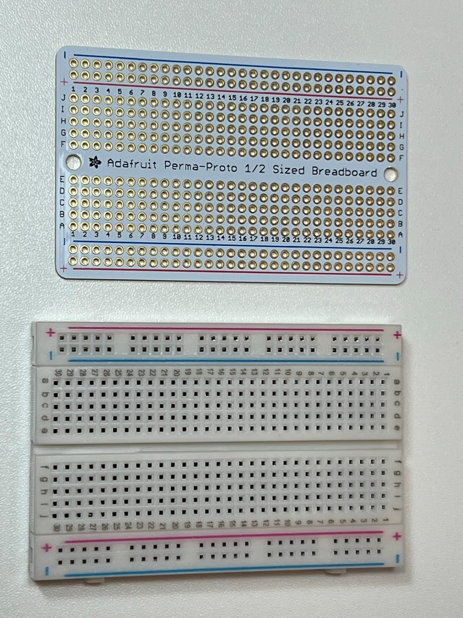
breadboard
Solderless breadboard

Slide 14
Components

Slide 15
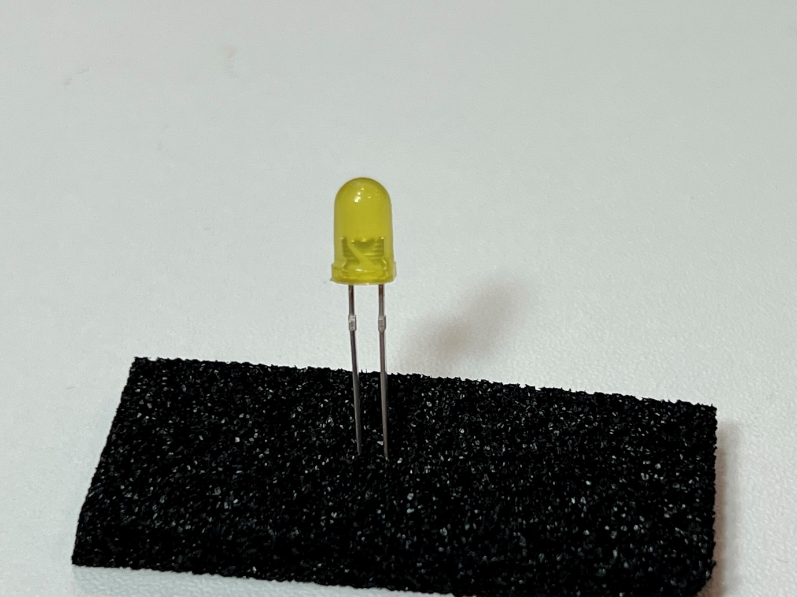
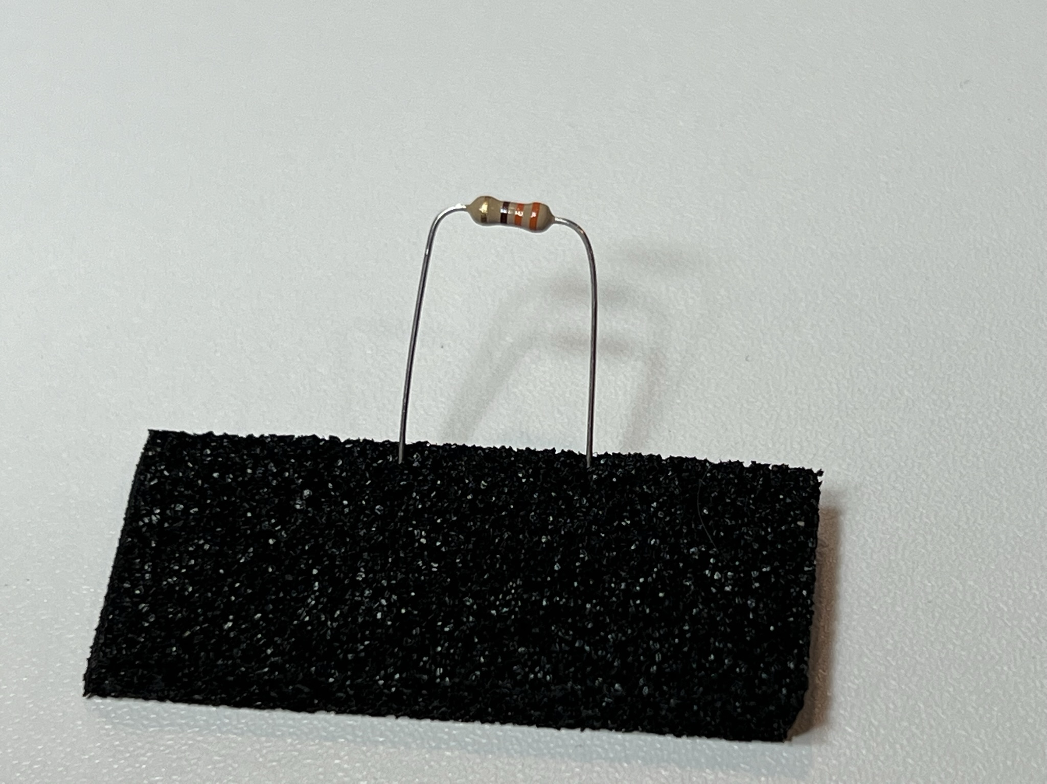
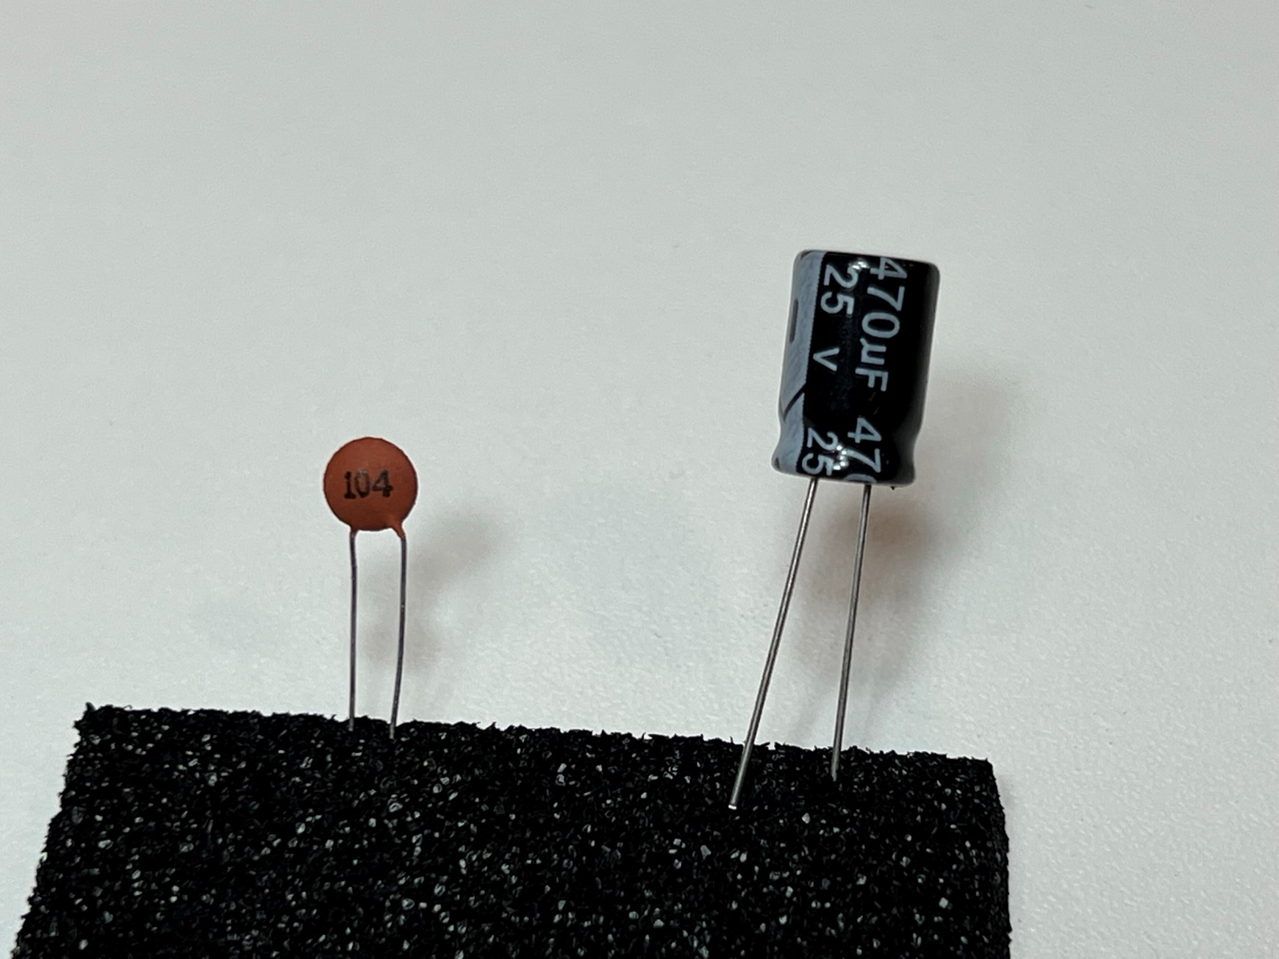
Through-hole LED
Through-hole Resistor
Ceramic Capacitor
Electrolytic Capacitor

Slide 16
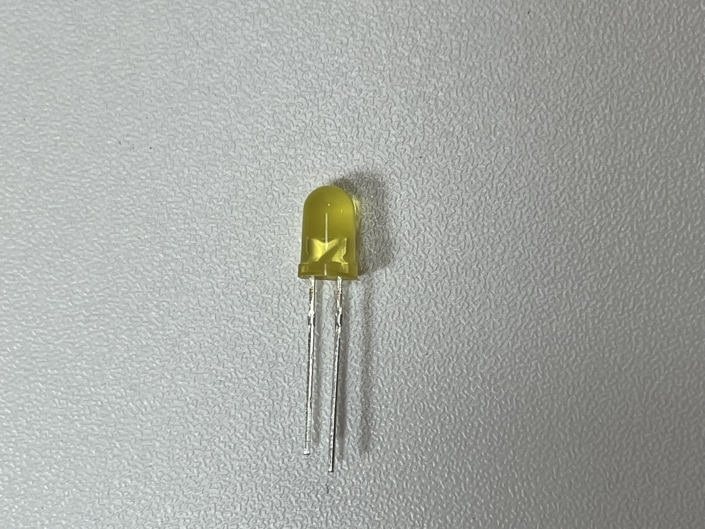
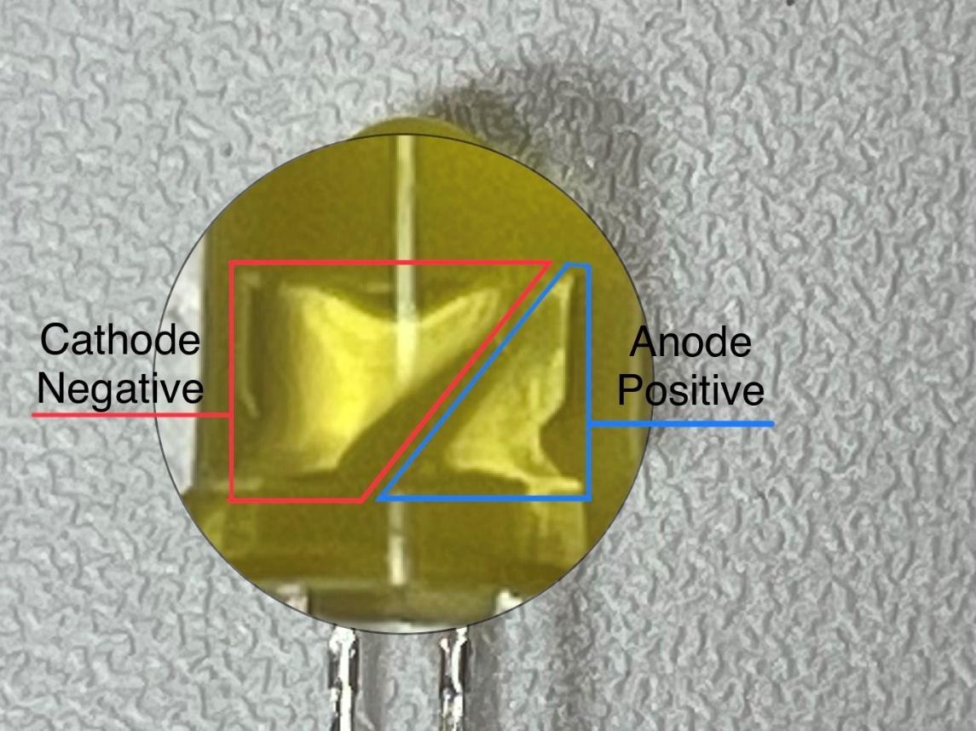
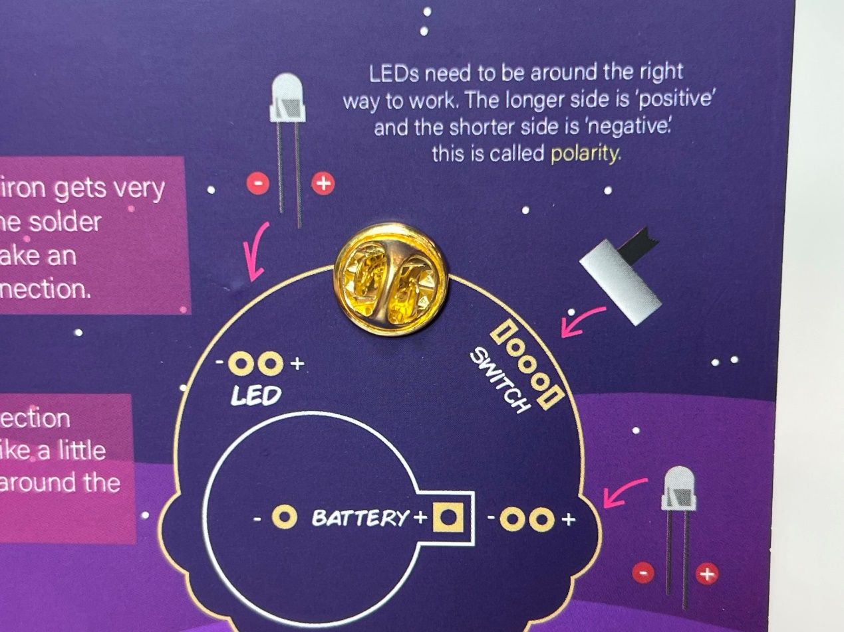
Through-hole LED
-
+
LEDs are polarized which means they need to be installed the correct way. Usually, the longer leg is positive, and the shorter leg is negative.
Learn to identify Cathode vs Anode. I have seen mistakes in the length of legs too many times.

Slide 17
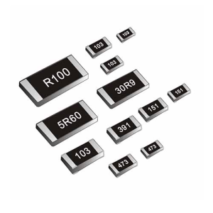
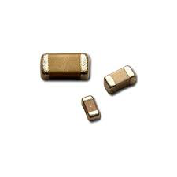
Surface Mount Devices
SMD Resistors
Smd capacitors

Slide 18
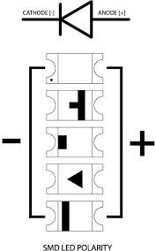
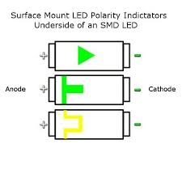
SMD LEDs

Slide 19
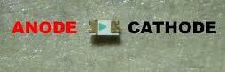
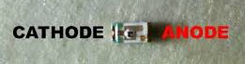
SMD LEDs

Slide 20
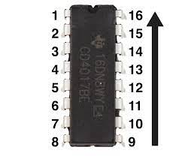
Integrated circuit (IC)
an electronic circuit formed on a small piece of semiconducting material, performing the same function as a larger circuit made from discrete components.

Slide 21
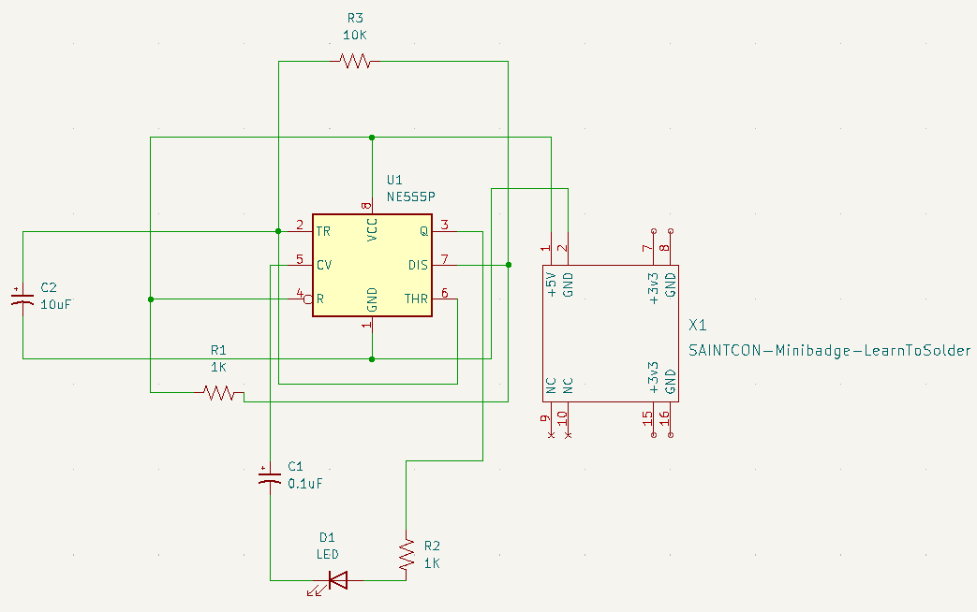
Learn to solder minibadge: 555 timer circuit

Slide 22
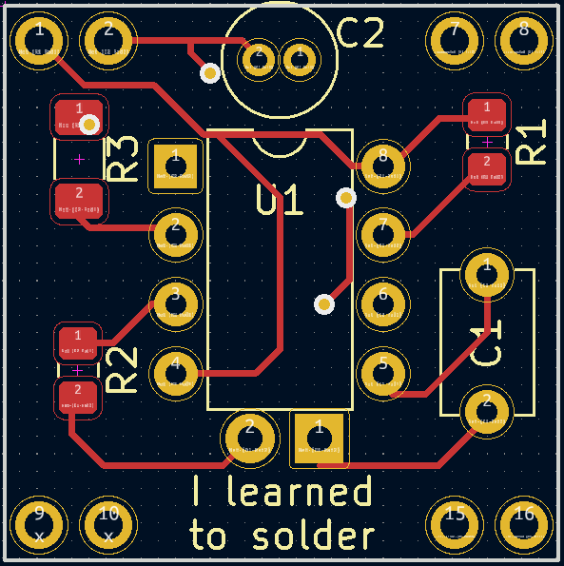
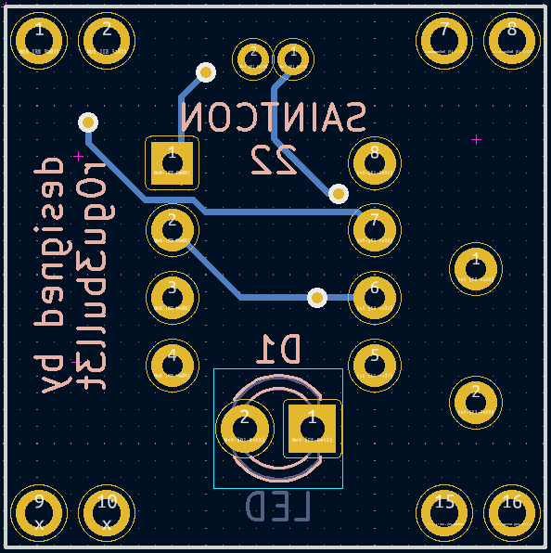
Learning to Solder minibadge
front
back

Slide 23
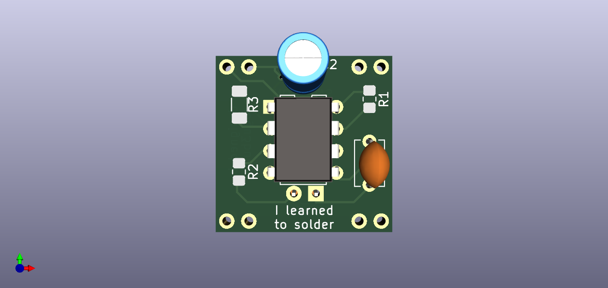
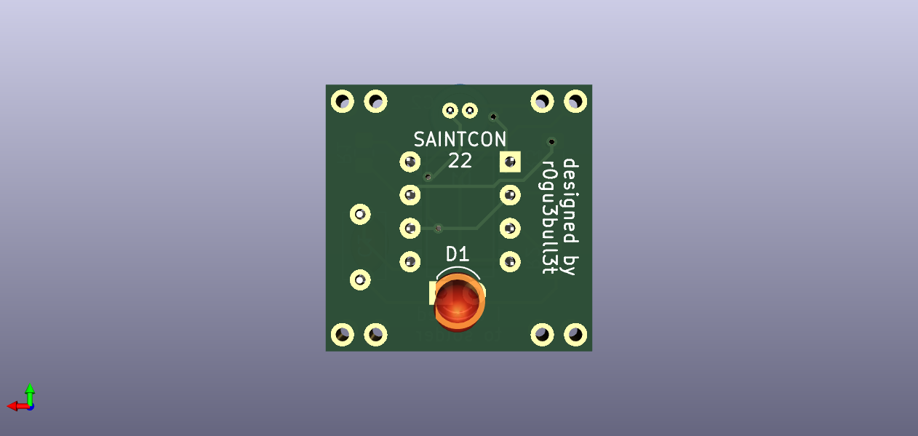
Front
back

